Slide 1

Panic At The Desktop Project 1
Jack Harvey, Svitlana nAZARcHUK , Adib Khan, Shawn Cavalieri

Slide 2
mETHODology
Our goal:
To specifically look at the impact of the Great Recession of 2008 on Unemployment, Median Housing Prices, and birth rate.
Question we are trying to answer:
What were the general trends regarding unemployment, housing prices, and birth rate after the great recession? Can we draw any conclusions from the data?
What data did we use/how did we use it?
We used data from the …. , …., …., and …. that showed the civilian labor force (CLF), unemployment rates, birth rates, and median housing prices by state from 2007 to 2018
We used the civilian labor force as the main group, and binned each state by it’s CLF count
The main bins for this presentation are states with over 5,000,000 CLF population and states with under 1,000,000 CLF population
How did we clean the data:
Began with information of all states and counties, needed to remove county level information
Renamed columns, dropped columns, merged datasets, changed all strings to floats so they could be graphed
Used a for loop to compare all of the data we needed at once vs. 50 different functions
Binned data based on CLF size and median house price to compare against each other

Slide 3
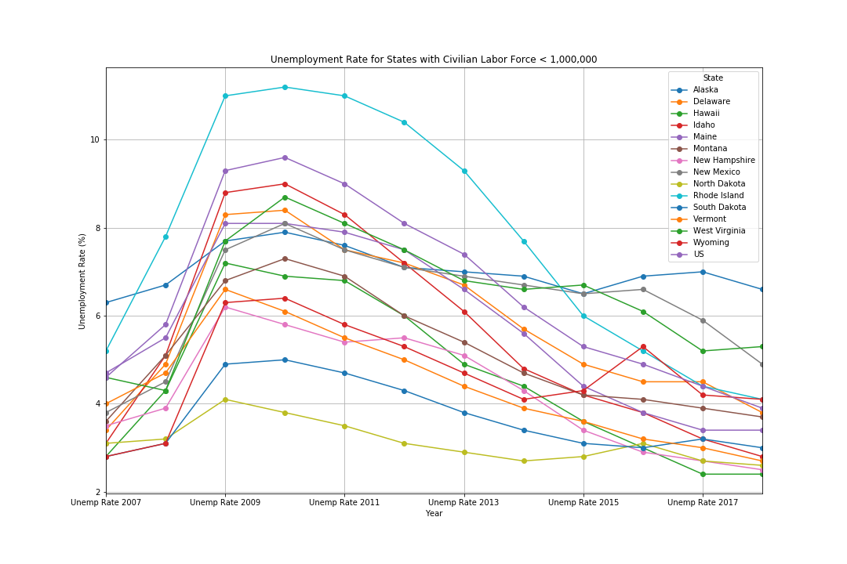
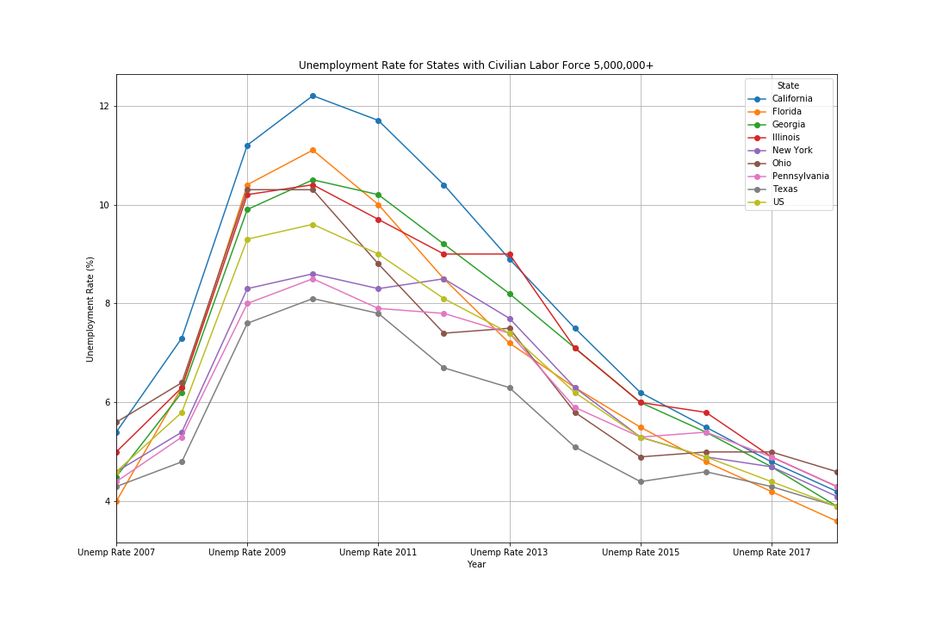
Part #1 – unemployment Rates vs. CLF
Conclusions
The number of CLF has no impact on the general trend of decrease in unemployment.
We can see that unemployment reaches its peak at every state in either 2009/2010. This peak remains here for every state regardless of the CLF population. Then after this peak, you can see a decreasing trend of unemployment in all states

Slide 4
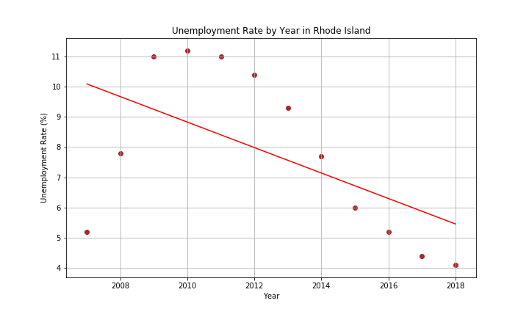
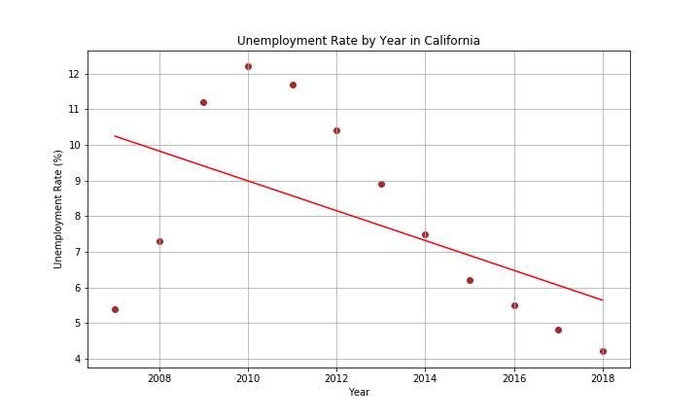
Part #1 – unemployment Rates vs. CLF COntinued
Conclusions
The number of CLF has no impact on the general trend of decrease in unemployment.
We can see that unemployment reaches its peak at every state in either 2009/2010. This peak remains here for every state regardless of the CLF population. Then after this peak, you can see a decreasing trend of unemployment in all states

Slide 5
Part #2 – Median House Price
Insert FIG of “House Price for states with price > $500,000”
Conclusions
Rhode Island and California largest and smallest, but both in highest bin for home price
CLF does not influence median housing price

Slide 6
Part #3 – unemployment Rates vs. Median House Price
Insert FIG of “House Price By Year for California”
Insert FIG of “California scatter plot by year home price vs. unemployment”
Conclusions
Prices started high while unemployment rate was low, then recession hit and prices dropped while unemployment rates increased, then prices increased as unemployment rates returned to pre-recession levels

Slide 7
Part #3 – unemployment Rates vs. Median House Price
Insert FIG of “Rhode Island Scatter Plot by year home price vs. unemployment”
Insert Fig of “House Price by Year for Rhode Island”
Conclusions
Prices started high while unemployment rate was low, then recession hit and prices dropped while unemployment rates increased, then prices increased as unemployment rates returned to pre-recession levels

Slide 8
Part #4 – unemployment Rates vs. Birth Rates
Insert Figs for Birth Rate Region 1
Insert Figs for Unemployment Rate Region 1
Conclusions
Birth Rate at a 30 year low
Utah has the lowest median age and majority of the population belongs to The Church of Jesus Christ of Latter-day Saints (Mormons). VT, NH, RI, CT and Massachusets have majors metropolitan areas and majors Ivy league Universities. All except RI are among 10 the most educated states in US. Woman who pursue higher education and focused on career are less likely to have kids or large families. These states are also have high median age, older women are less likely to have kids.

Slide 9
Part #4 – unemployment Rates vs. Birth Rates
Insert Figs for Birth Rate region 8
Insert Figs for Unemployment Rate region 8
Conclusions
Birth Rate at a 30 year low
Utah has the lowest median age and majority of the population belongs to The Church of Jesus Christ of Latter-day Saints (Mormons). VT, NH, RI, CT and Massachusets have majors metropolitan areas and majors Ivy league Universities. All except RI are among 10 the most educated states in US. Woman who pursue higher education and focused on career are less likely to have kids or large families. These states are also have high median age, older women are less likely to have kids.

Slide 10
Final Conclusions
Size of the state doesn’t have a huge impact, CLF no impact, unemployment yes vs. housing price, birth rate no vs. unemployment

Slide 11

Thank You
someone@example.com

